Slide 1
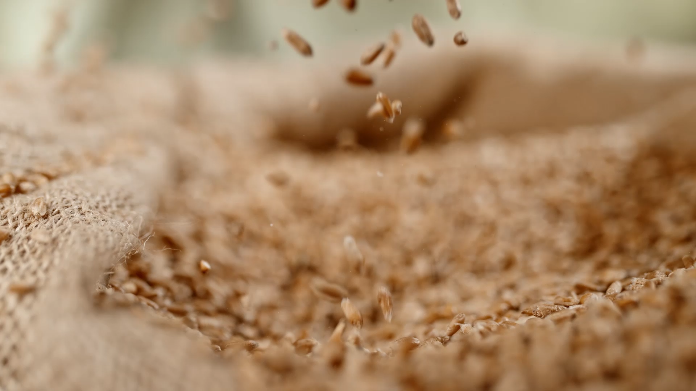
Illinois Soybean Growing Environment Forecast
Team Member:
Daniel Zhang Hirokazu Kanei
Pengfei Gu Zhaochen Ye
University of Chicago – Master of Science, Analytics
June 1st, 2022

Slide 2

Problem Statement
Commodity Trading
USDA End-of-Season Report
Business Impact of the Project
In general, commodities are divided into four categories: metals, energy, livestock and meat, and agricultural goods.
Producer and Speculator agree on the crop price ahead of time.
Important for investors who wish to diversify investment options
The crop production summary is a report of the year-end crop acreage, yield, and production estimates for grains and hay; oilseeds; cotton, tobacco, and sugar; dry beans, peas, and lentils; and potatoes and miscellaneous crops.
Investors can make data-driven decisions in the commodity trading market by having early understanding of the end-of-season soybean yield forecasts, using forecasted environmental features that affect soybean yield

Slide 3
Data Explanation
Data Source:
Global Historical Climatology Network daily (GHCNd)
Moderate Resolution Imaging Spectroradiometer (MODIS) by NASA
Relevant Features:
TMAX: Max Temp of the day
TMIN: Min Temp of the day
PRCP: Daily Precipitation
NDWI: Normalized Difference Water Index
NDVI: Normalized Difference Water Index
LST_day: Land Surface Temp mean for Daytime
LST_night: Land Surface Temp mean for night
GHCNd
MODIS

Slide 4
Assumptions
The State level data could be aggregated from county level data using mean of each feature
We only consider the Natural and Objective features that are universally available to each county.
Soil or biologically related specific features are not included
There is an 8-day gap between each time stamp to reduce the autocorrelation of each feature, especially for Temperature related features
Eventually, the soybean yield can be calculated from features repeatedly throughout a year with respective day_of_year stamps

Slide 5
Exploratory Analysis

Slide 6
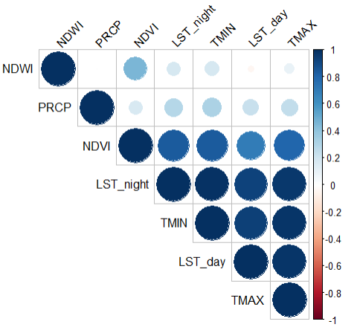
Correlation Heatmap
Temperature measures are heavily correlated with each other
Precipitation anti-intuitively doesn’t have correlation with water index
Vegetation index has high positive correlation with all other features

Slide 7
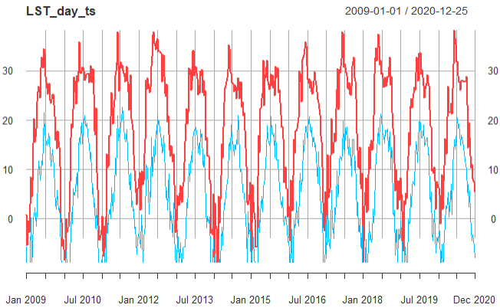
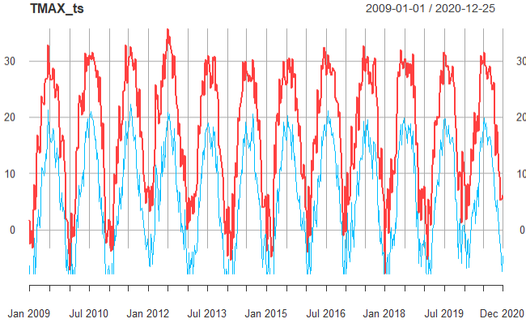
Land Surface Temperature Day vs. Night
Daily Max Temperature vs. Min Temperature

Slide 8
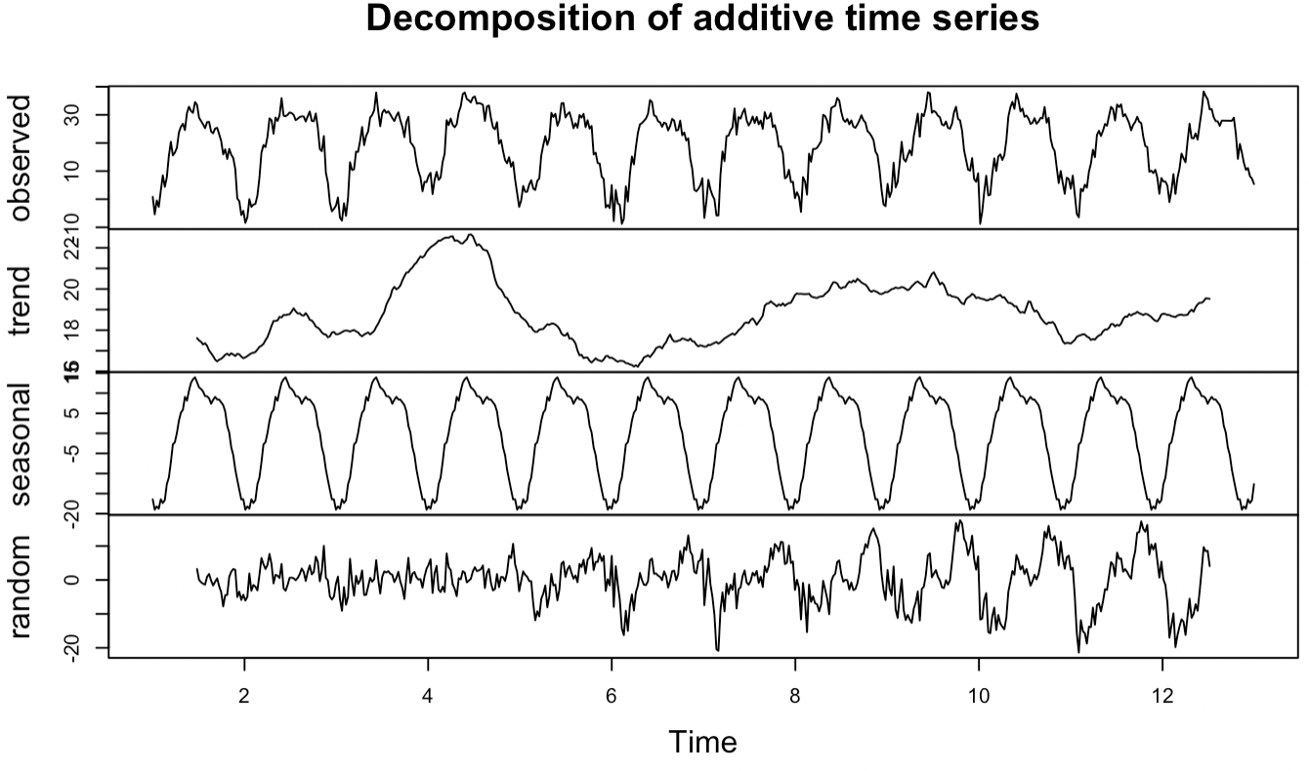
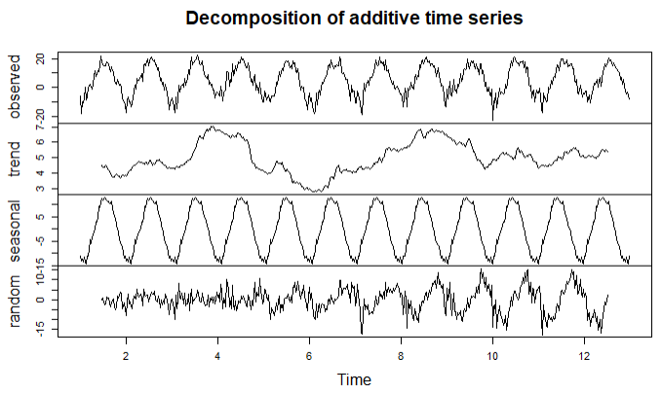
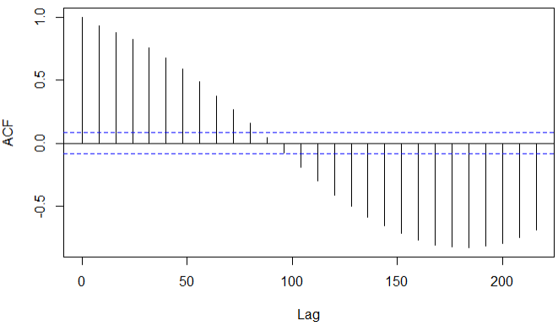
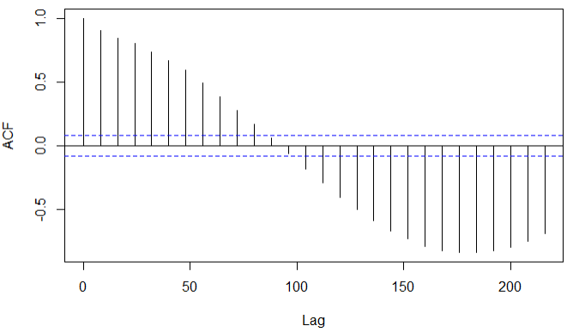
Land Surface Temperature During the Day
Land Surface Temperature During the Night
Omega:
71.12%
Omega:
72.45%

Slide 9
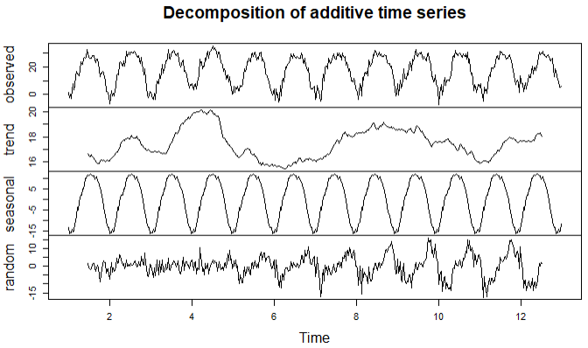
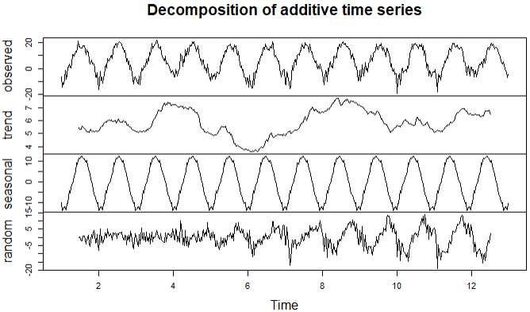

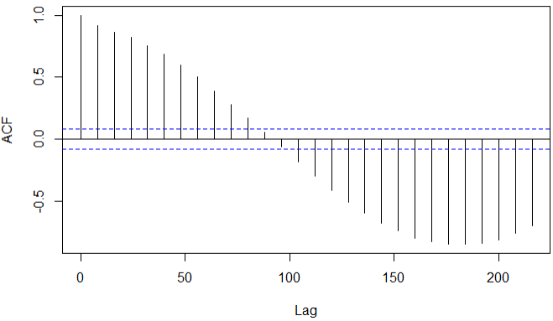
Daily Maximum Temperature
Daily Minimum Temperature
Omega:
74.23%
Omega:
71.12%

Slide 10
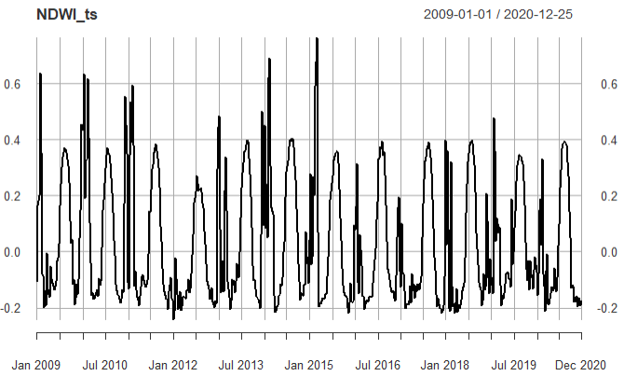
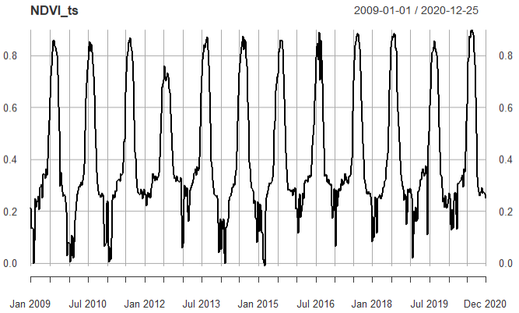
Vegetation Water Index
Vegetation Index

Slide 11
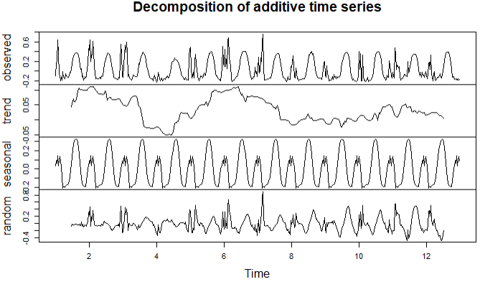
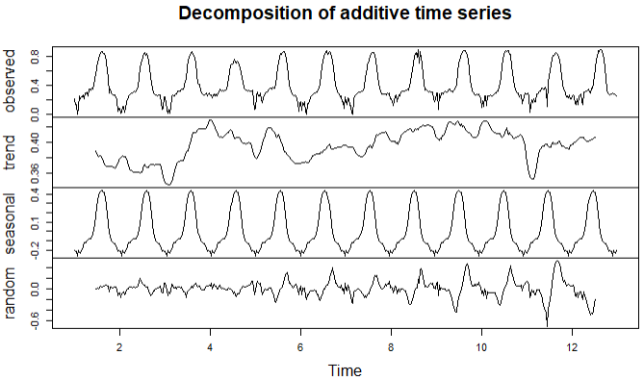
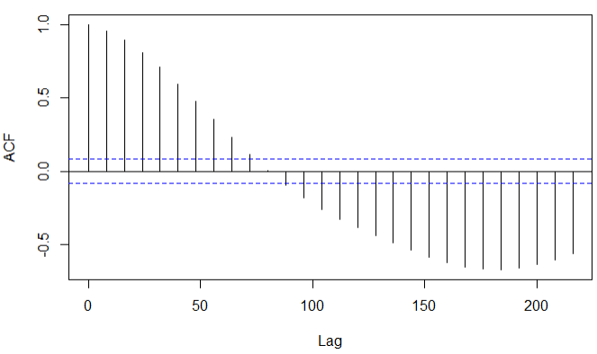
Vegetation Water Index
Vegetation Index
Omega:
42.35%
Omega:
70.19%

Slide 12
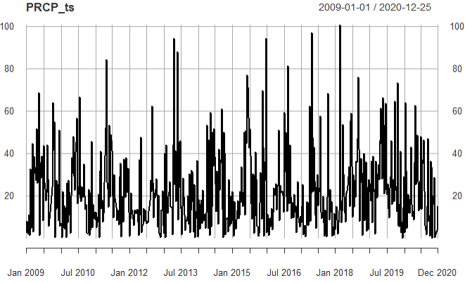
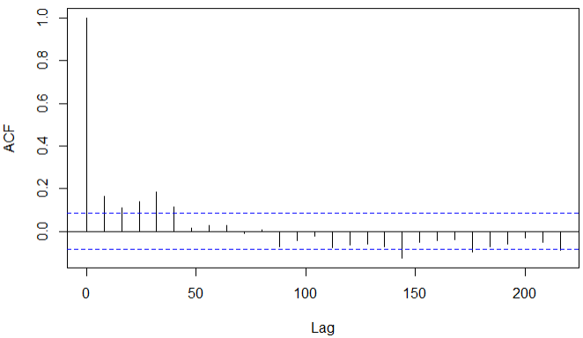
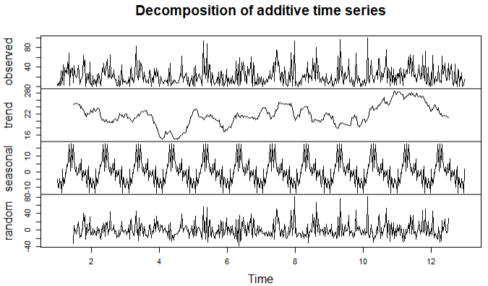
Precipitation
Omega: 10.17%

Slide 13
Forecasting Models

Slide 14
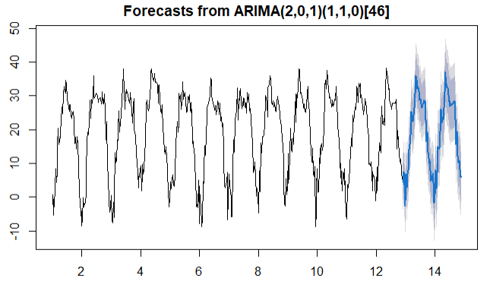
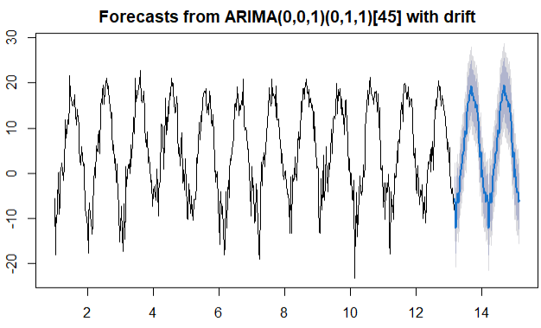
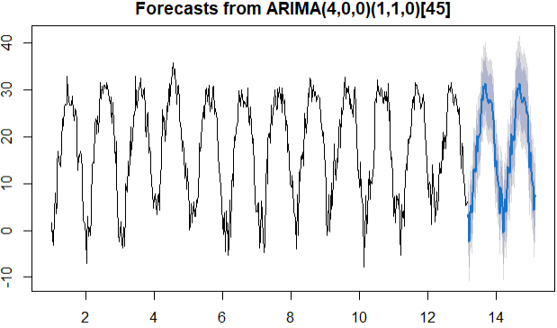
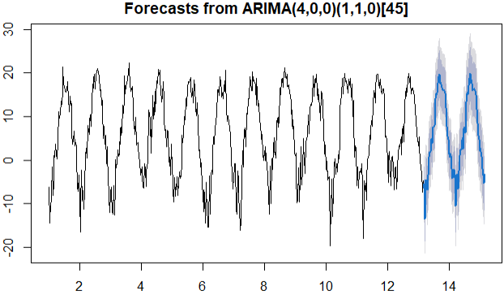
Seasonal ARIMA (SARIMA)
LST_day
LST_night
Max Temp
Min Temp

Slide 15
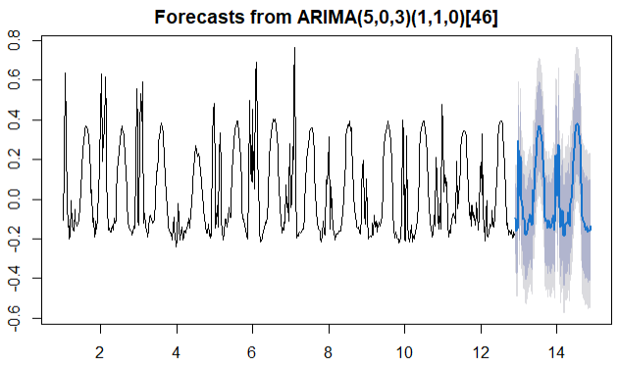
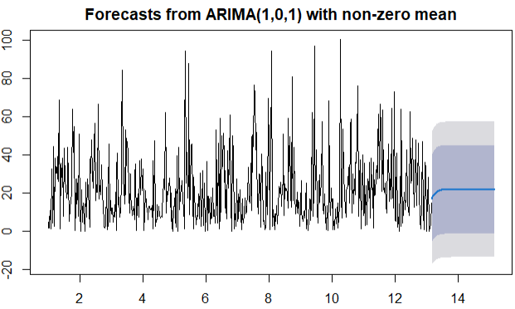
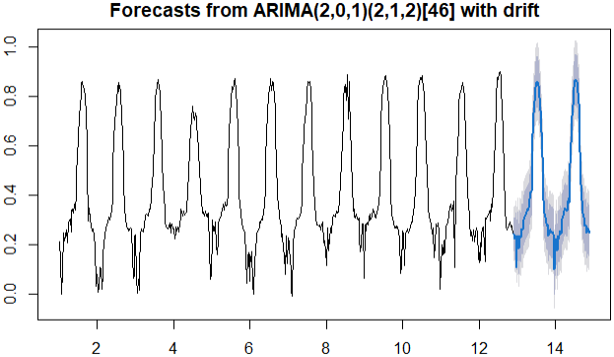
Seasonal ARIMA (SARIMA)
Water Index
Precipitation
Vegetation Index

Slide 16
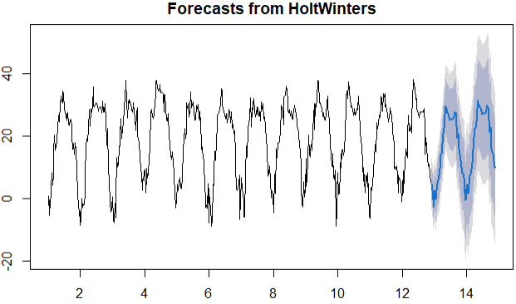
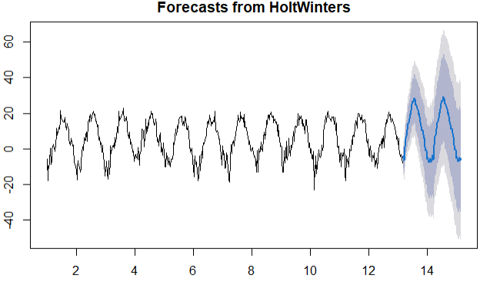
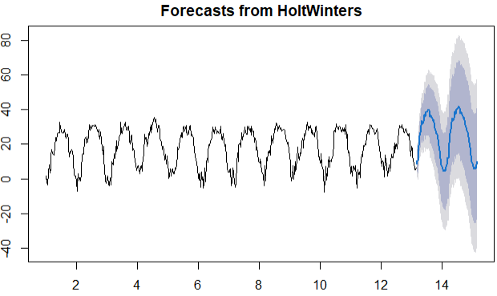
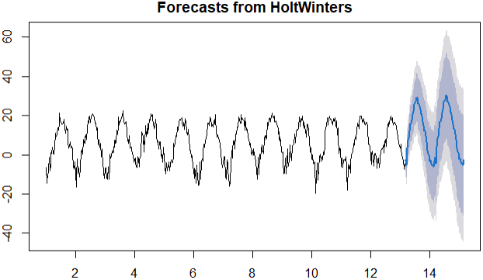
Holt-Winters
LST_day
LST_night
Max Temp
Min Temp

Slide 17
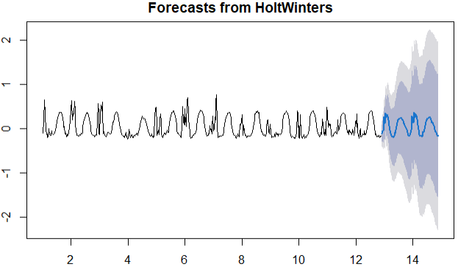
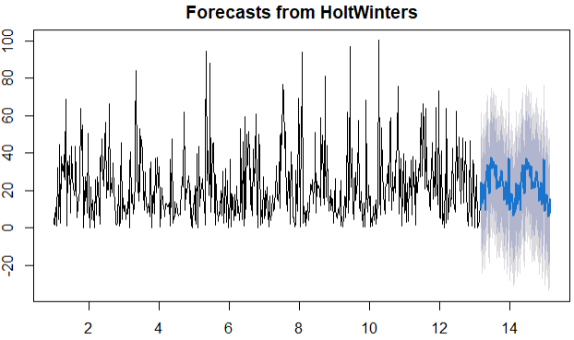
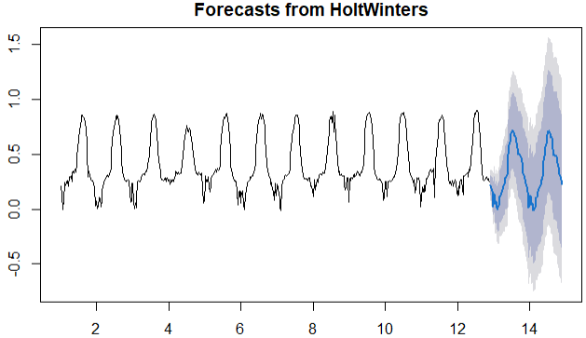
Holt-Winters
Water Index
Precipitation
Vegetation Index

Slide 18
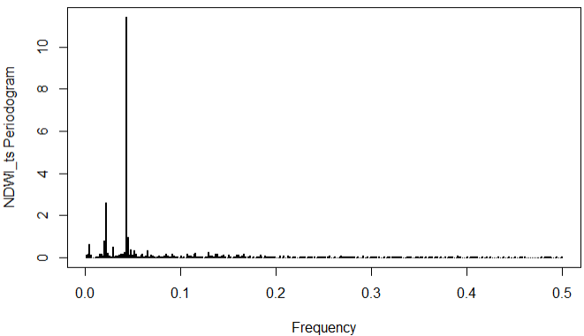
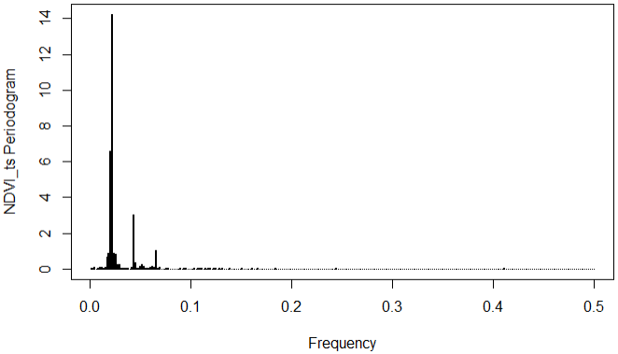
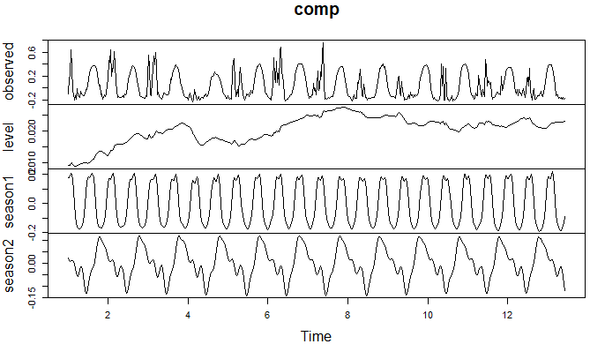
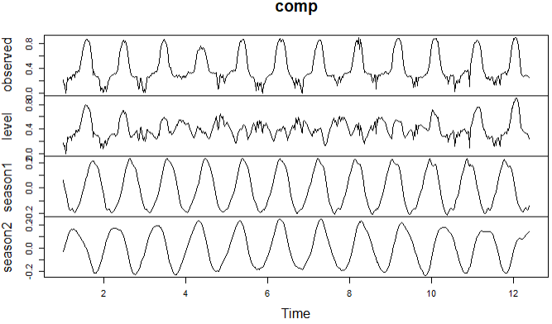
Multiple Seasonality
All the temperature features and the precipitation show no significant multiple seasonality
However, both vegetable index and water index exhibit multiple seasonality
Water Index
Vegetation Index

Slide 19
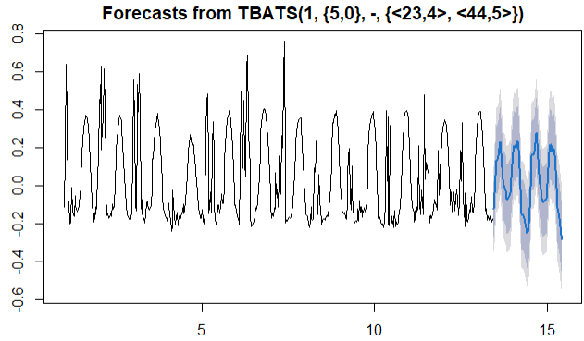
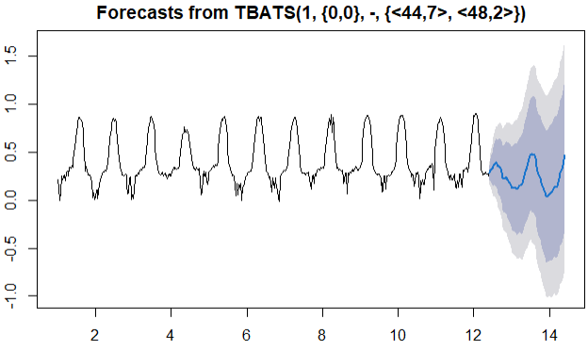
Forecasting TS with Multiple Seasonality
Water Index
Vegetation Index

Slide 20
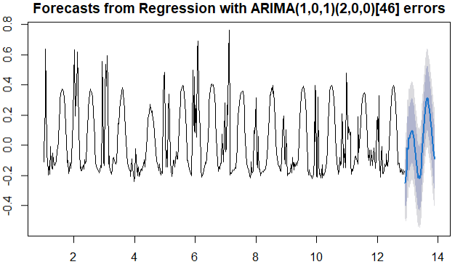
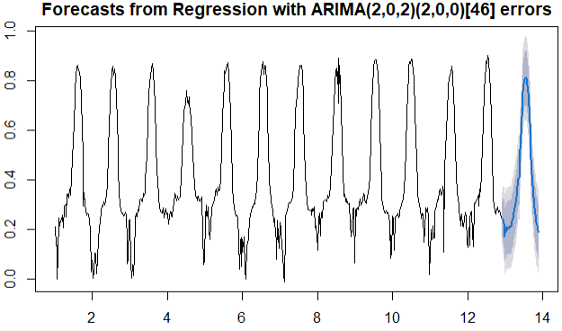
Fourier Based Arima
Fourier follows the same wavenumber K, which is the multiple seasonal amount
Water Index
Vegetation Index

Slide 21
Conclusions

Slide 22
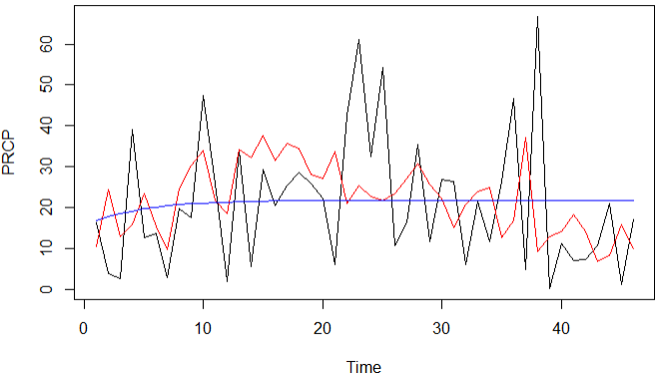
Performance Comparison
We chose RMSE to be our model evaluation metric:
Actual
SARIMA
Holt-Winter
For all the features, the SARIMA generates the best results, with also the longest training runtime
Holt-winter and SARIMA performed similarly for Precipitation. Although HW captured some real fluctuations, it forecasted more opposite results that caused its worse performance

Slide 23
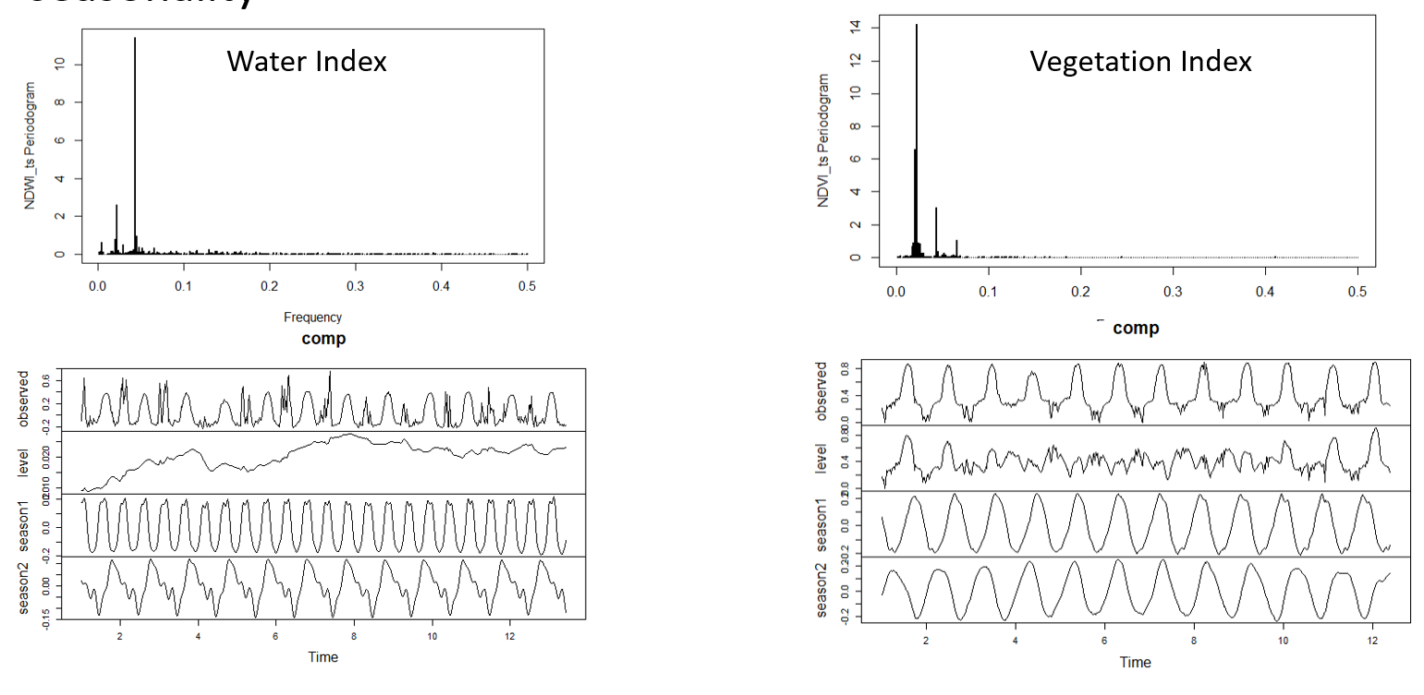
Findings
Holt-Winter models needs more tuning to better capture the weak seasonal data with high randomness
Multiple seasonal ARIMA model may not perform well when the second seasonal pattern is not significant enough, or the frequency difference in seasonal pattern is small

Slide 24
Future Work & Suggestions
We could include more relevant features that has impact on the crop’s growing condition
For example: soil parameters, seed quality, and crop condition survey results
We could potentially use forecasted environment features to predict yearly soybean yield early in a growing season using regression models
Furthermore, prediction of crop yield and production will provide better understanding of their commodity price index

Slide 25
Thanks!
Q&A

